Slide 1
AI Textbook Q&A System
A RAG-Based Educational Question Answering System with Deep Source Tracing
Wang, Peng | Yoo, Hye Ran
CST8507: Natural Language Processing — Assignment 2
April 3, 2026

Slide 2
Introduction
Problem & Motivation
Problem: Students must navigate 46+ AI/ML textbooks to find answers
Goal: Ask a natural language question → Get an accurate, sourced answer
Key Innovation — Deep Source Tracing:
• Not just citing a book title — pinpoints the exact page & region
• Click any source → see the original PDF with highlighted area
Domain: AI, Machine Learning, NLP, Computer Vision
46 textbooks | 85,356 indexed chunks | ~500MB PDF data

Slide 3
Dataset
46 Canonical AI/ML Textbooks
Machine Learning
NLP
Mathematics
Vision / RL
Programming
8 books ISLR, ESL, PRML PML, Deep Learning
4 books SLP3, Eisenstein Manning IR
5 books MML, Boyd MacKay
3 books Szeliski, Sutton & Barto
5 books Fluent Python Clean Code
Total: 46 books | 85,356 chunks | ~500MB PDFs | Open-access / educational copies
Preprocessing: MinerU (DocLayout-YOLO) → Layout analysis → Specialized extraction (text, tables, formulas, figures) → Intelligent chunking with metadata (book, chapter, page, bbox)

Slide 4
Part 1: Method — RAG Architecture
4-Method Hybrid Retrieval + RRF Fusion
BM25 Keyword (SQLite FTS5)
User Query (Natural Language)
RRF Fusion (Reciprocal Rank Fusion)
Ollama LLM qwen2.5:0.5b (~0.4 GB)
Answer + Sources
Semantic Vector (ChromaDB)
TOC Tree (LLM Reasoning)
Metadata Filter (Structured)
Key Feature: Deep Source Tracing — Click any source → Original PDF page with highlighted bounding box region

Slide 5
Part 1: Streamlit UI Demo
Interactive search with source tracing
Search Interface
Result View
• 4 retrieval methods: BM25, Vector, TOC, Metadata
• Adjustable top-K sources (1-20)
• Library filter: select specific textbooks
• Model selector: qwen2.5:0.5b
• Related topic suggestions
• RAG-generated answer at top
• Source documents with relevance scores
• Click 'View PDF' → original page
• Highlighted bounding box on PDF
• Page navigation + zoom controls
46 books • 85,356 chunks • qwen2.5:0.5b (~0.4GB) • Runs 100% locally

Slide 6
Part 1: Evaluation
20 test questions across AI/ML/NLP domains
Scoring Method
Sample Questions
• 20 domain-specific questions prepared
• Manual assessment: 1 (correct), 0.5 (partial), 0 (incorrect)
• Top 3 retrieved documents per question
• Relevance marked for each source
• Final score = average across all 20 questions
1. What is neural attention?
2. Generative vs discriminative classifiers?
3. What is the Transformer architecture?
4. What is TF-IDF?
5. What is backpropagation?
6. What is Named Entity Recognition?
7. What is beam search?
8. What is transfer learning?
... (20 questions total)

Slide 7
Part 2: ROS 2 Integration
Converting RAG into a ROS 2 vocal interaction pipeline
1. MICROPHONE RecordingPublisher
2. WHISPER STT WordsPublisher
3. RAG + LLM OllamaPublisher
4. SPEAKER SpeakClient
5. TTS ENGINE SpeakService
recording
words
ollama_reply
speak
Implementation
Tech Stack
• ollama_publisher.py — New ROS 2 node (our Part 1 code)
• Subscribes to 'words' topic (Whisper output)
• Publishes to 'ollama_reply' topic (RAG answer)
• speak_client subscribes to 'ollama_reply' (not 'words')
• Local Ollama API + knowledge.txt for RAG context
• Ubuntu 22.04 on loaner laptop
• ROS 2 Humble + colcon build
• Ollama qwen2.5:0.5b (CPU, ~0.4GB)
• faster-whisper (small, int8) + Silero VAD
• gTTS for text-to-speech output

Slide 8
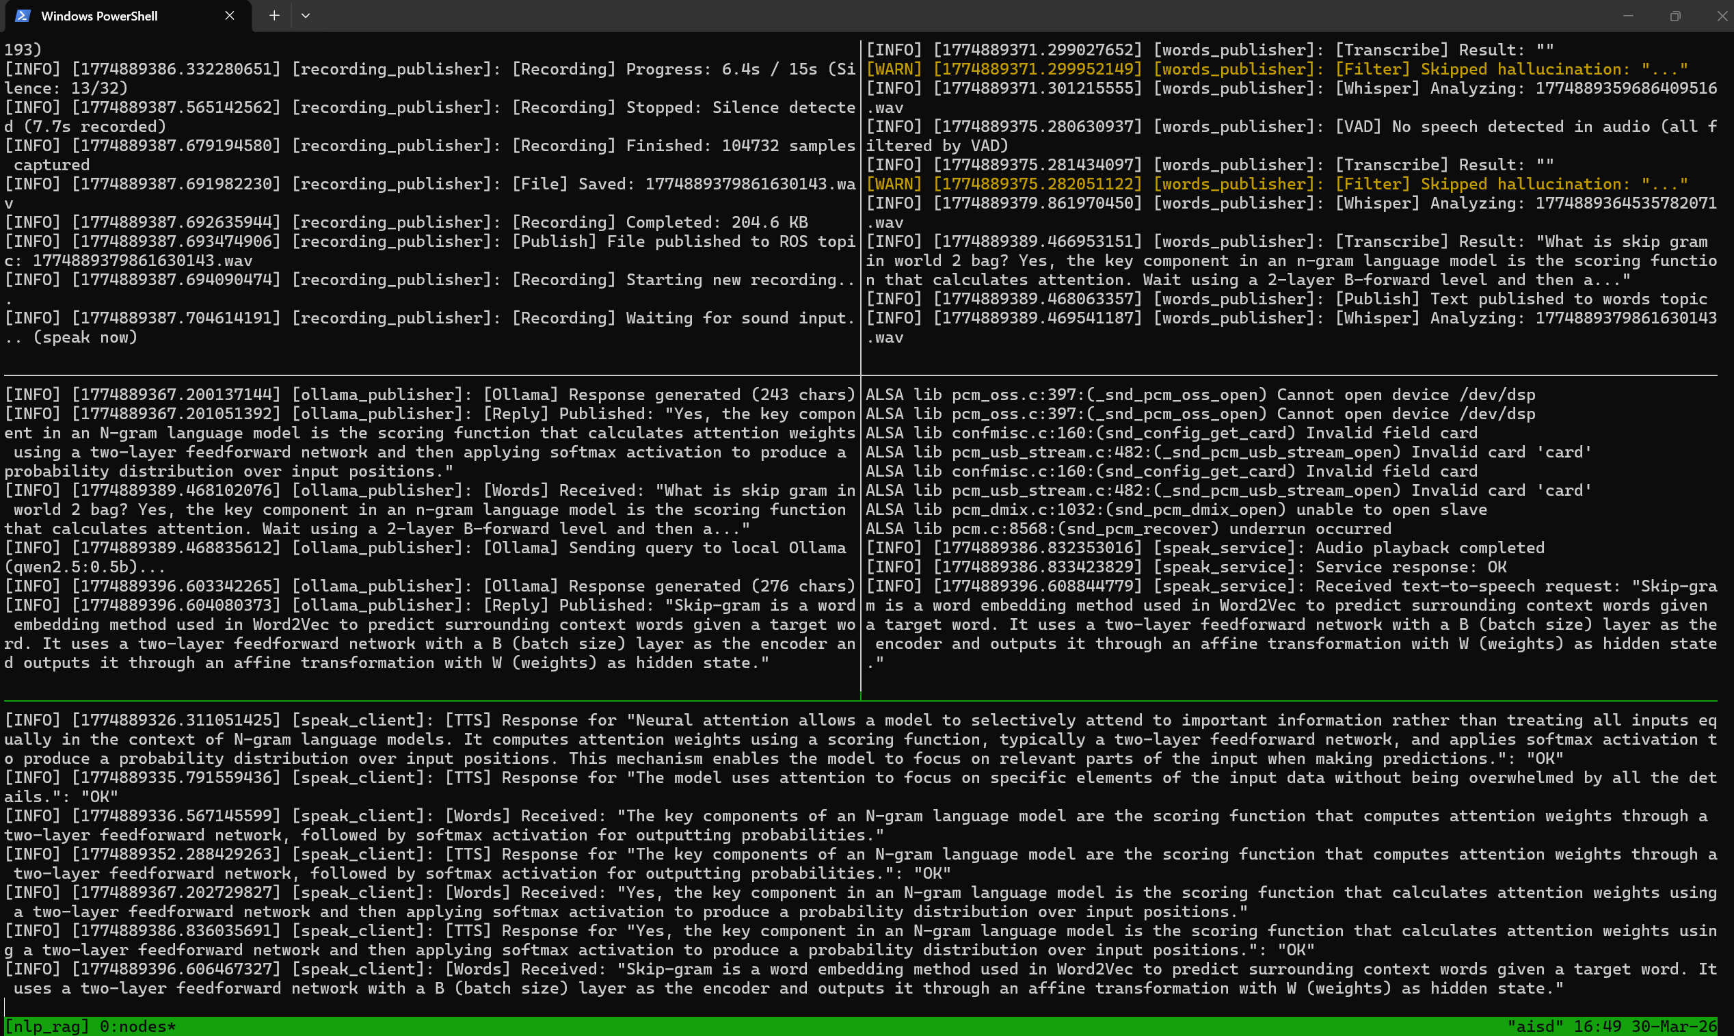
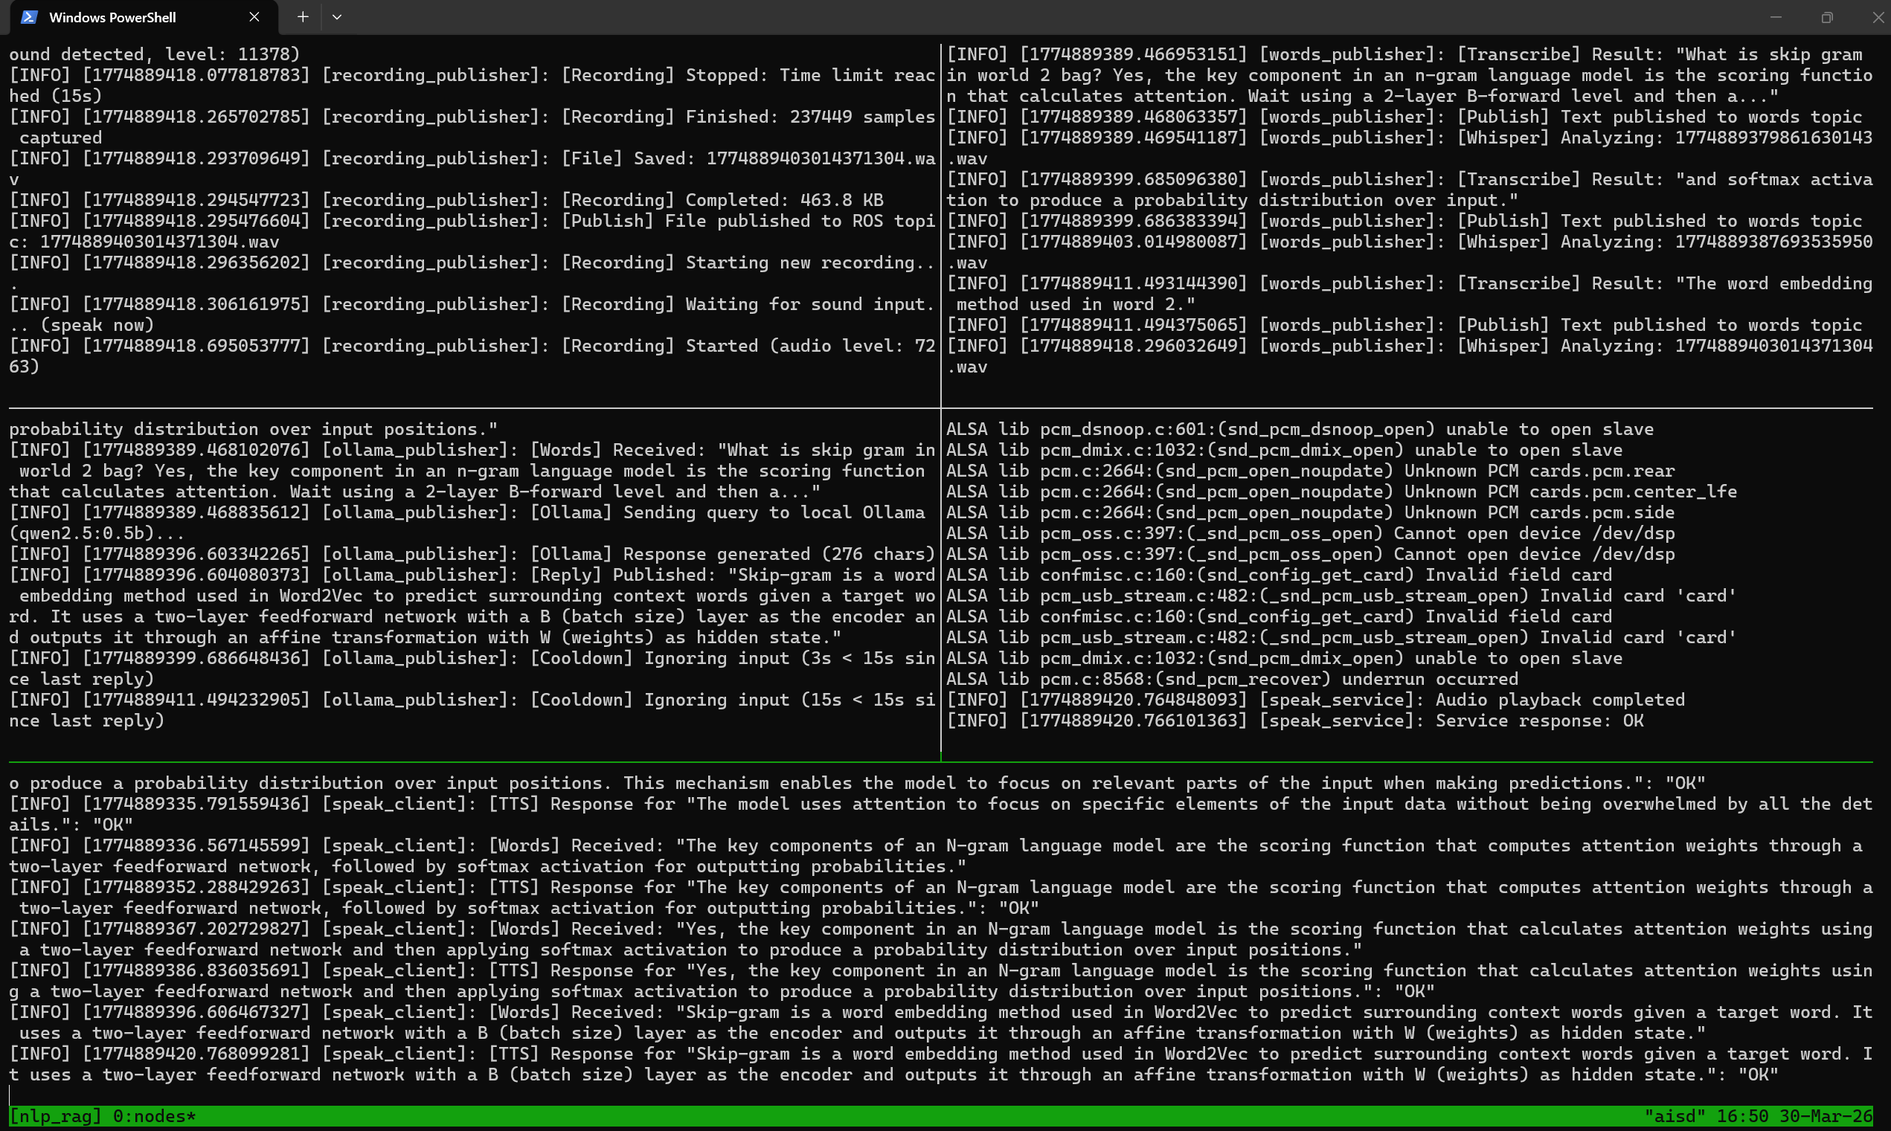
Part 2: ROS 2 Live Demo
5-node pipeline running on loaner laptop via tmux
Left: Q&A flow (attention, skip-gram questions) → Right: Continued responses + TTS playback confirmation Pipeline: Mic → Whisper → RAG + Ollama → gTTS → Speaker

Slide 9
Challenges & Solutions
Whisper Hallucinations
Added Silero VAD pre-filtering + custom hallucination detector (repetition, known phrases, trigram analysis)
Echo Loop (TTS → Mic)
15-second cooldown timer after each reply prevents the system from hearing its own TTS output
Resource Constraints
qwen2.5:0.5b (0.4GB) + faster-whisper int8 quantization enables 3 AI models (Whisper + Ollama + gTTS) on one CPU laptop
Cross-Platform Deploy
Automated bat/sh scripts: SCP sync → colcon build → tmux launch One-click deployment from Windows to Ubuntu loaner laptop

Slide 10
Discussion & Future Work
Limitations
Future Work
• Small LLM (0.5B) limits generation quality
• Single-turn Q&A only (no conversation memory)
• Knowledge file is static (no live updates)
• CPU inference is slow (~10-15s per response)
• Upgrade to larger models (qwen2.5:3b) with GPU
• Multi-turn conversation with context memory
• Dynamic knowledge base updates via API
• Multi-language support (Korean, Chinese, English)
• Integration with robotic hardware (iRobot Create 3)
Conclusion: We built a complete voice-interactive RAG pipeline — from 46 textbooks to real-time voice Q&A on a robot-ready ROS 2 platform. The system demonstrates that meaningful AI assistance is possible even with a 0.4GB model.

Slide 11
Thank You
Questions?
Wang, Peng | Yoo, Hye Ran CST8507: Natural Language Processing GitHub: github.com/LannieYoo/nlp_project

